Slide 1
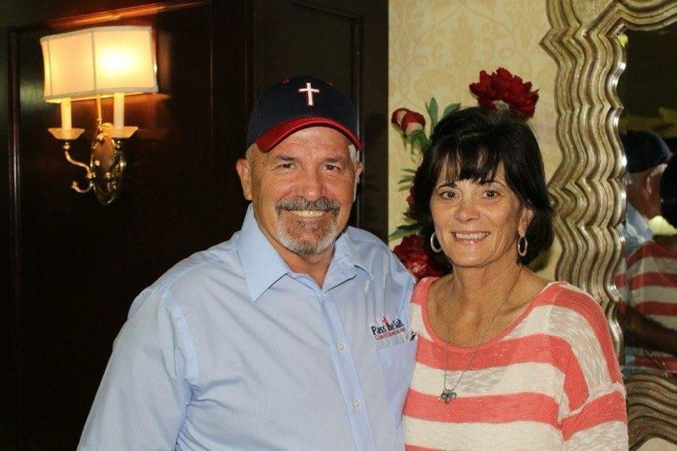

COACH DAVE & MICHELLE DAUBENMIRE

Slide 2

02 / 24

Slide 3
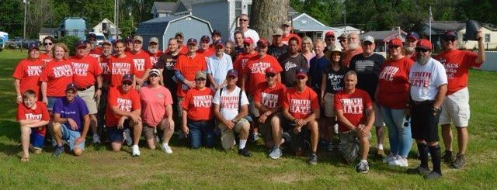
PASS THE SALT TEAM
03 / 24

Slide 4
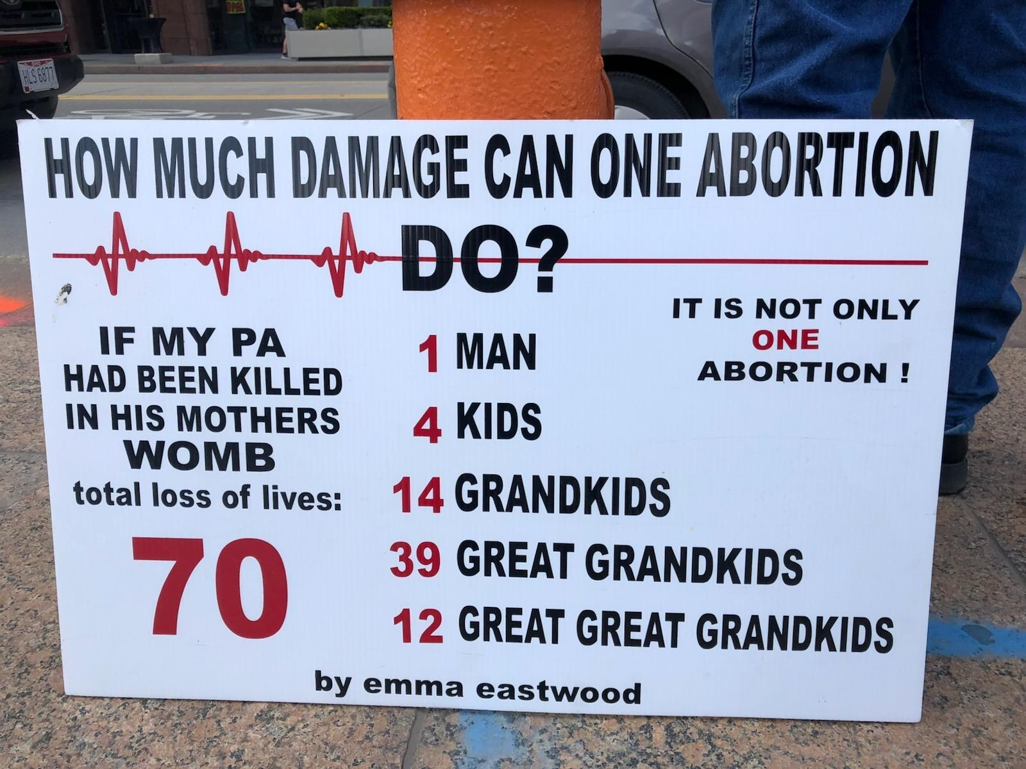
04 / 24
Roadside signage.

Slide 5
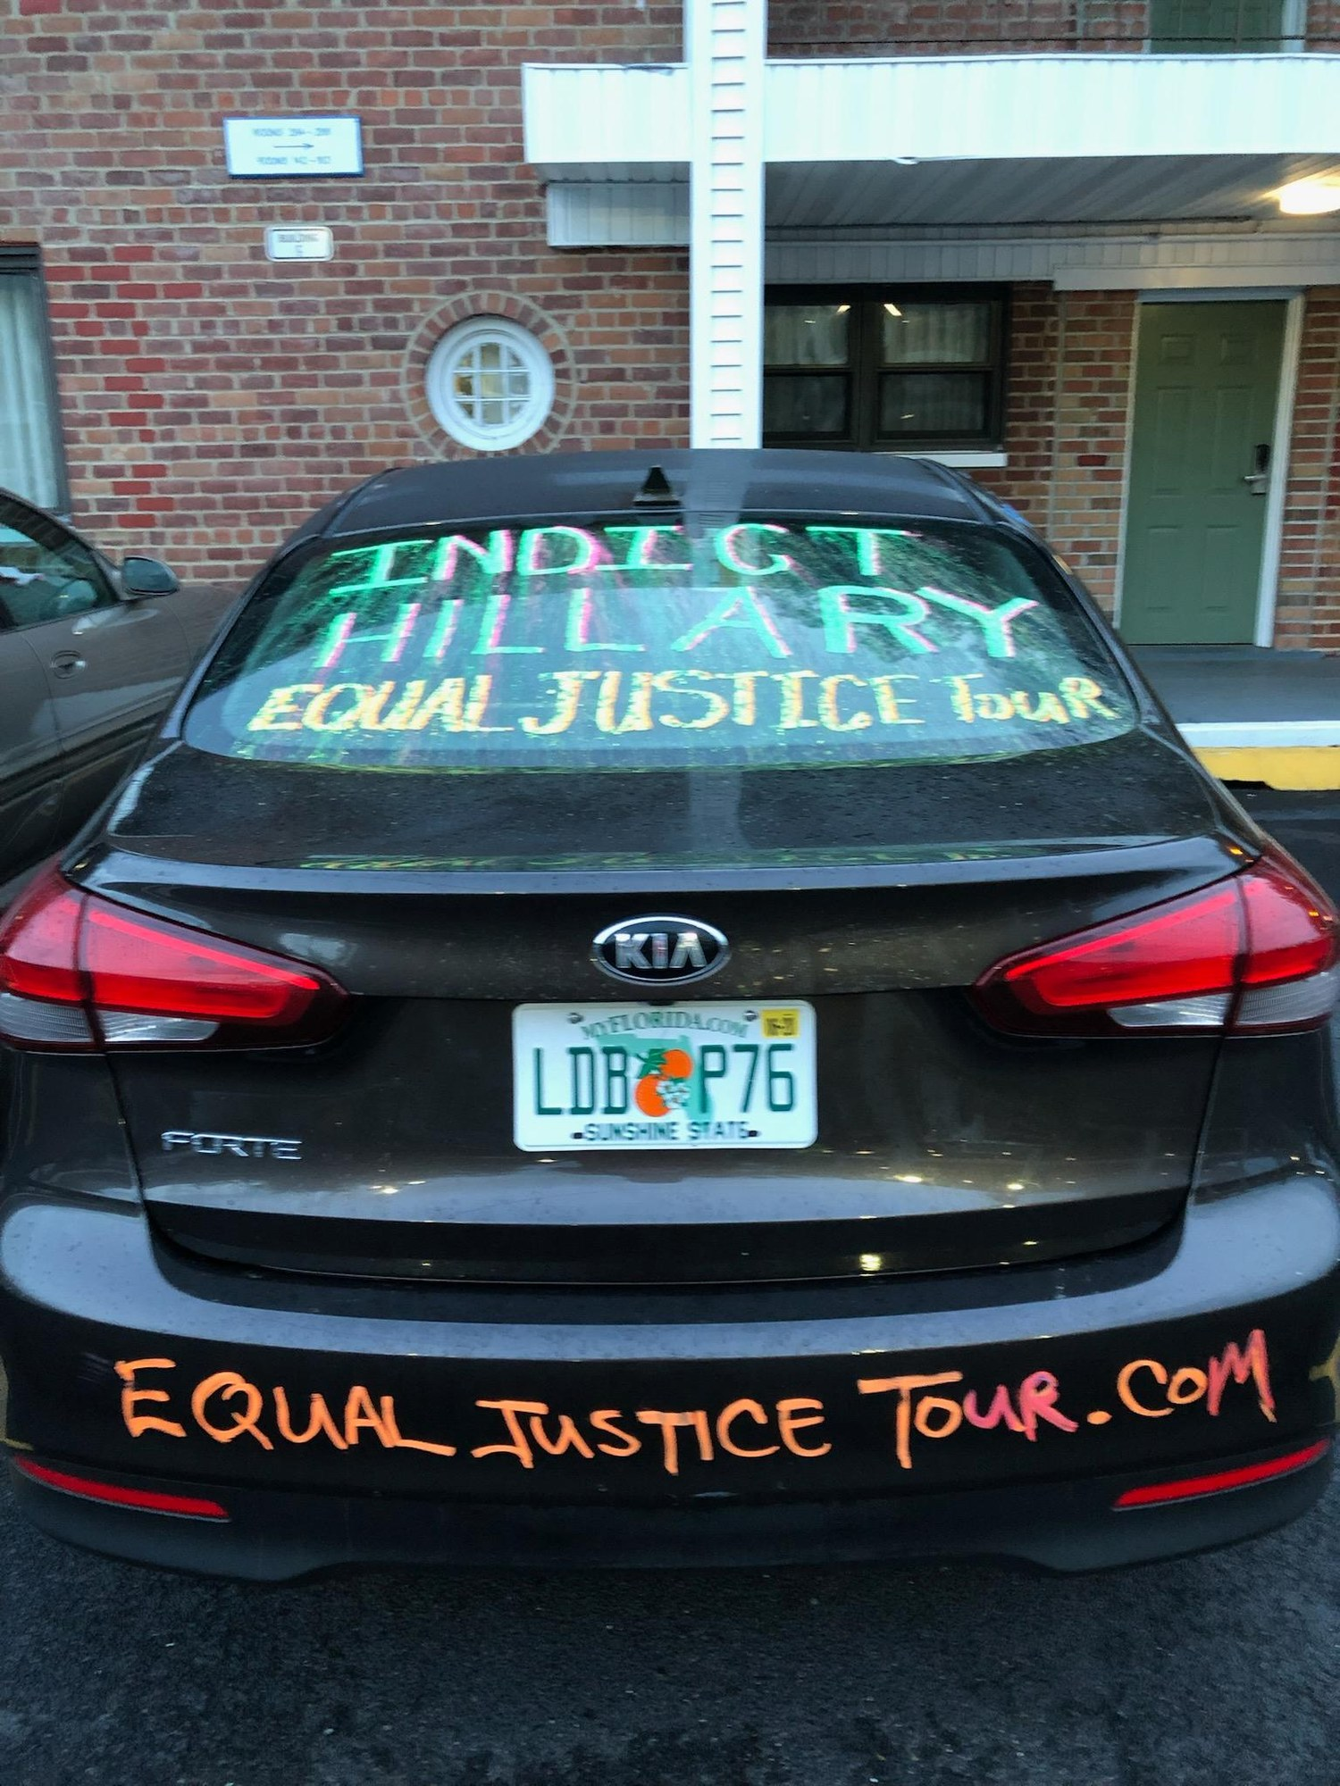
EQUAL JUSTICE TOUR
05 / 24
The ‘Indict Hillary’ car.

Slide 6
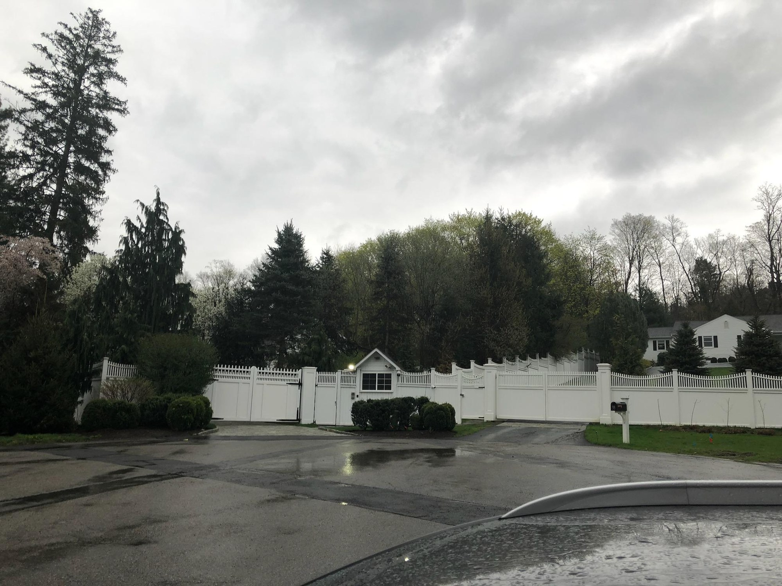
EQUAL JUSTICE TOUR
06 / 24
The Clinton residence.

Slide 7
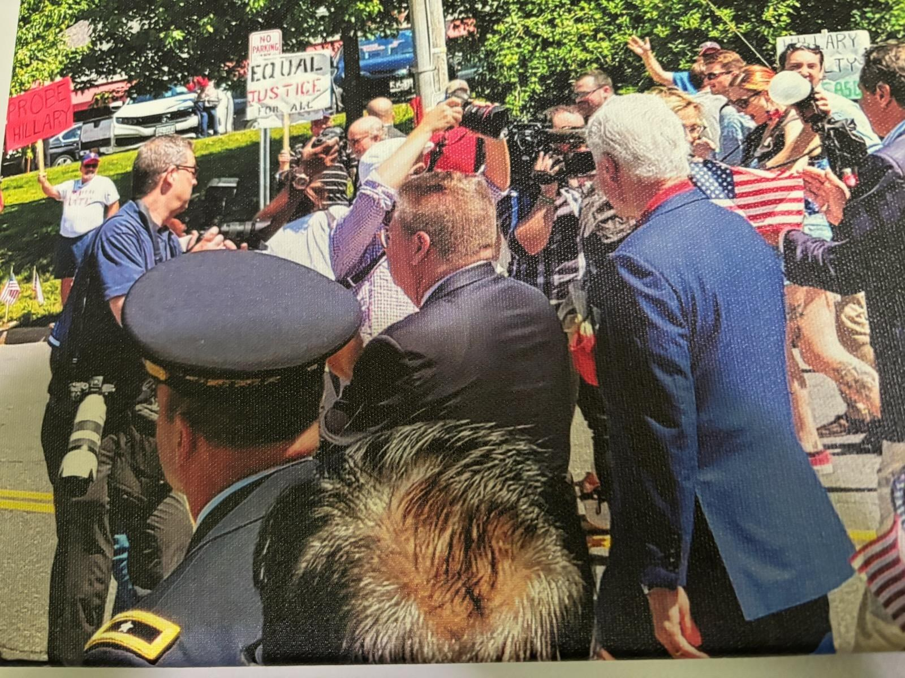
EQUAL JUSTICE TOUR
07 / 24
Bill Clinton.

Slide 8
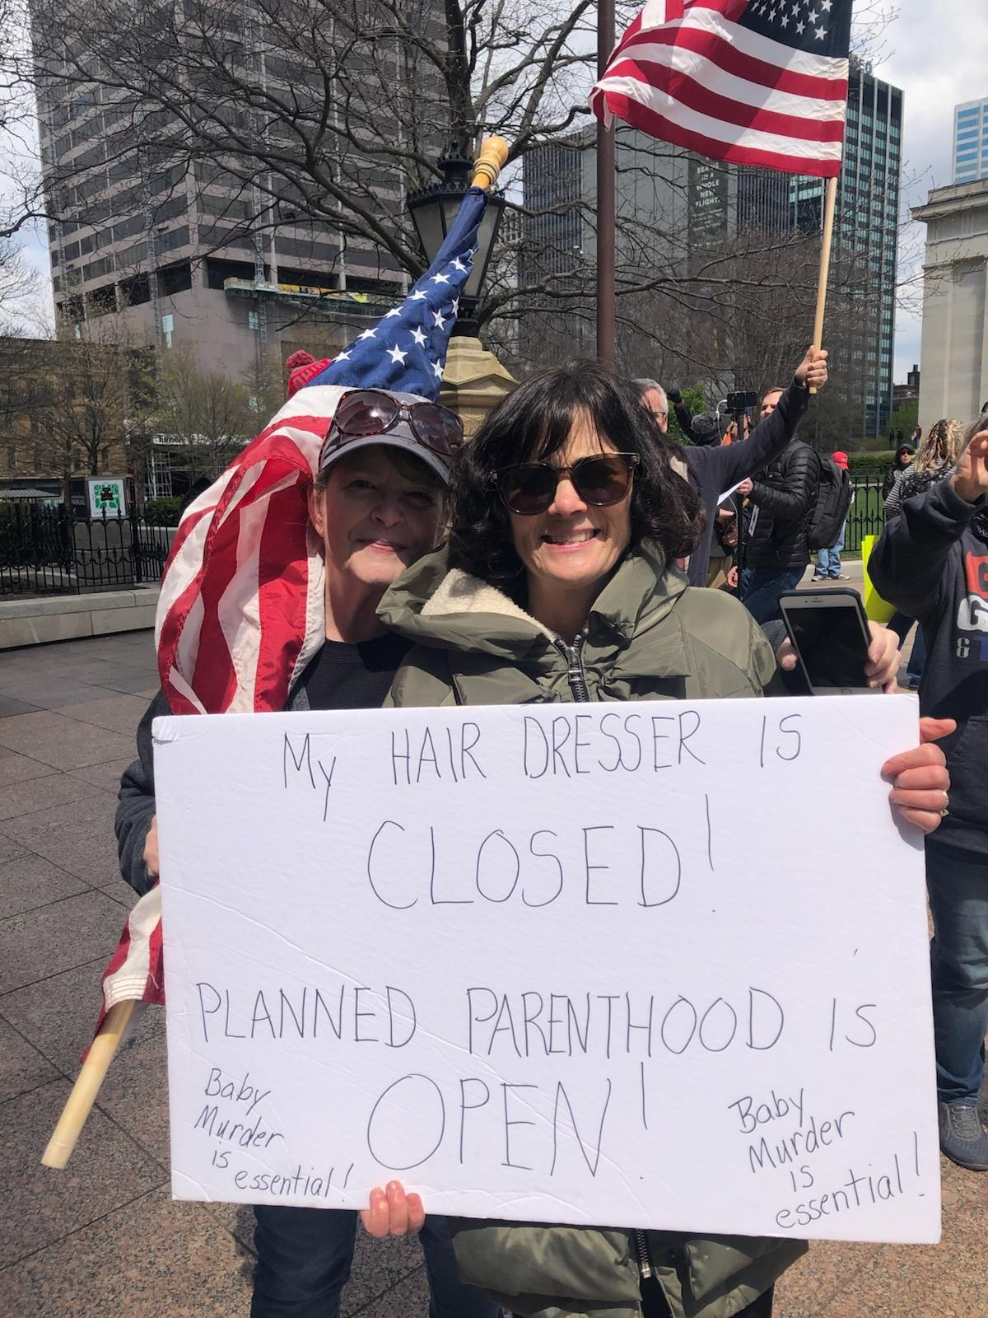
08 / 24

Slide 9
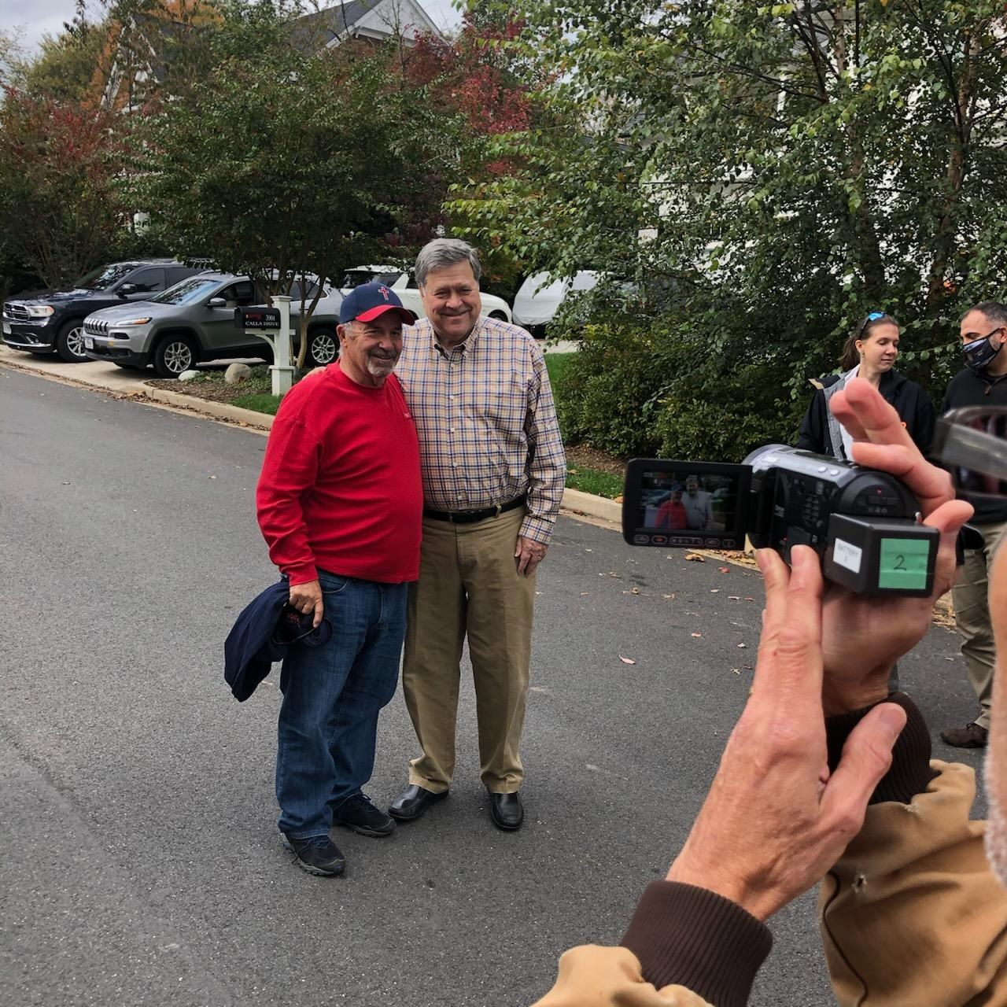
09 / 24
Bill Barr.

Slide 10
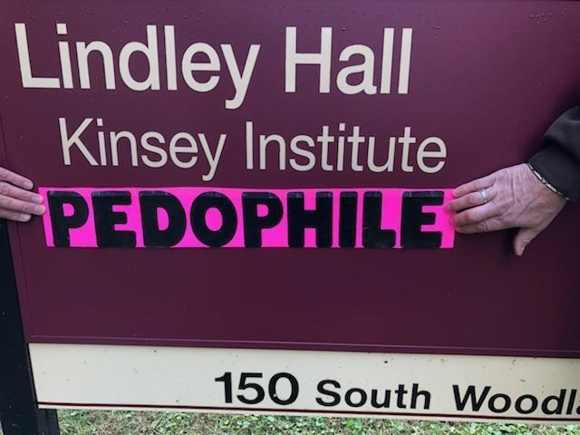
10 / 24

Slide 11
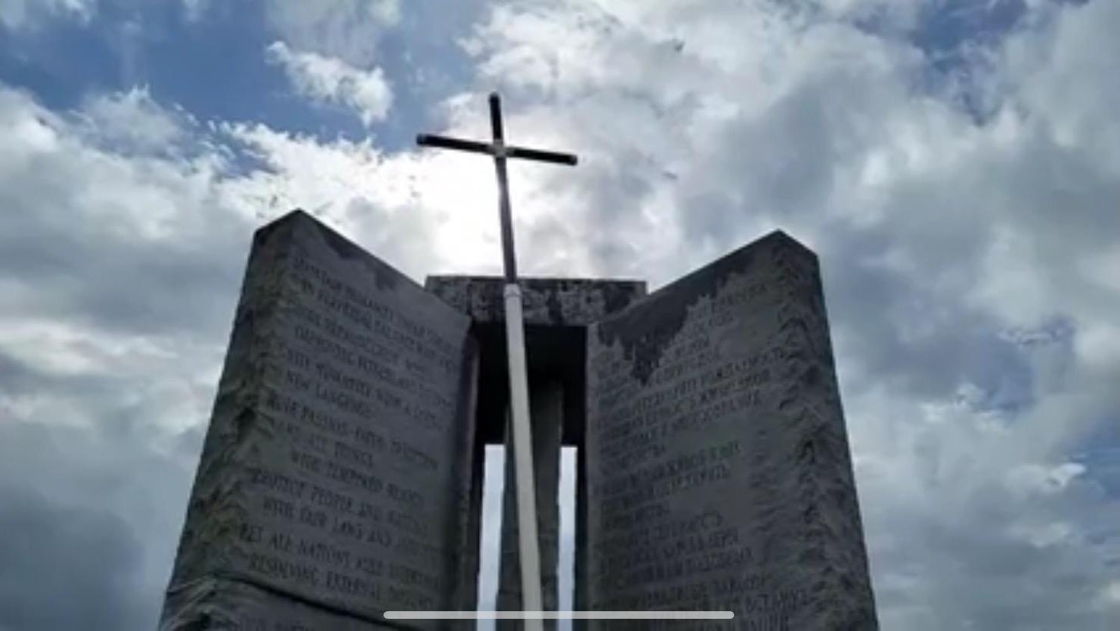
GEORGIA GUIDESTONES BEFORE
11 / 24
Before.

Slide 12
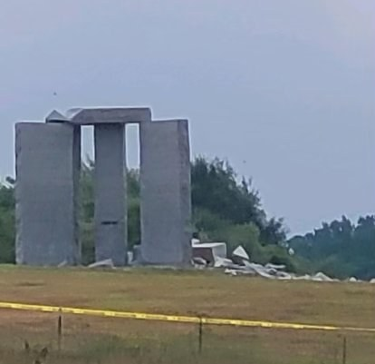
GEORGIA GUIDESTONES AFTER
12 / 24
After.

Slide 13
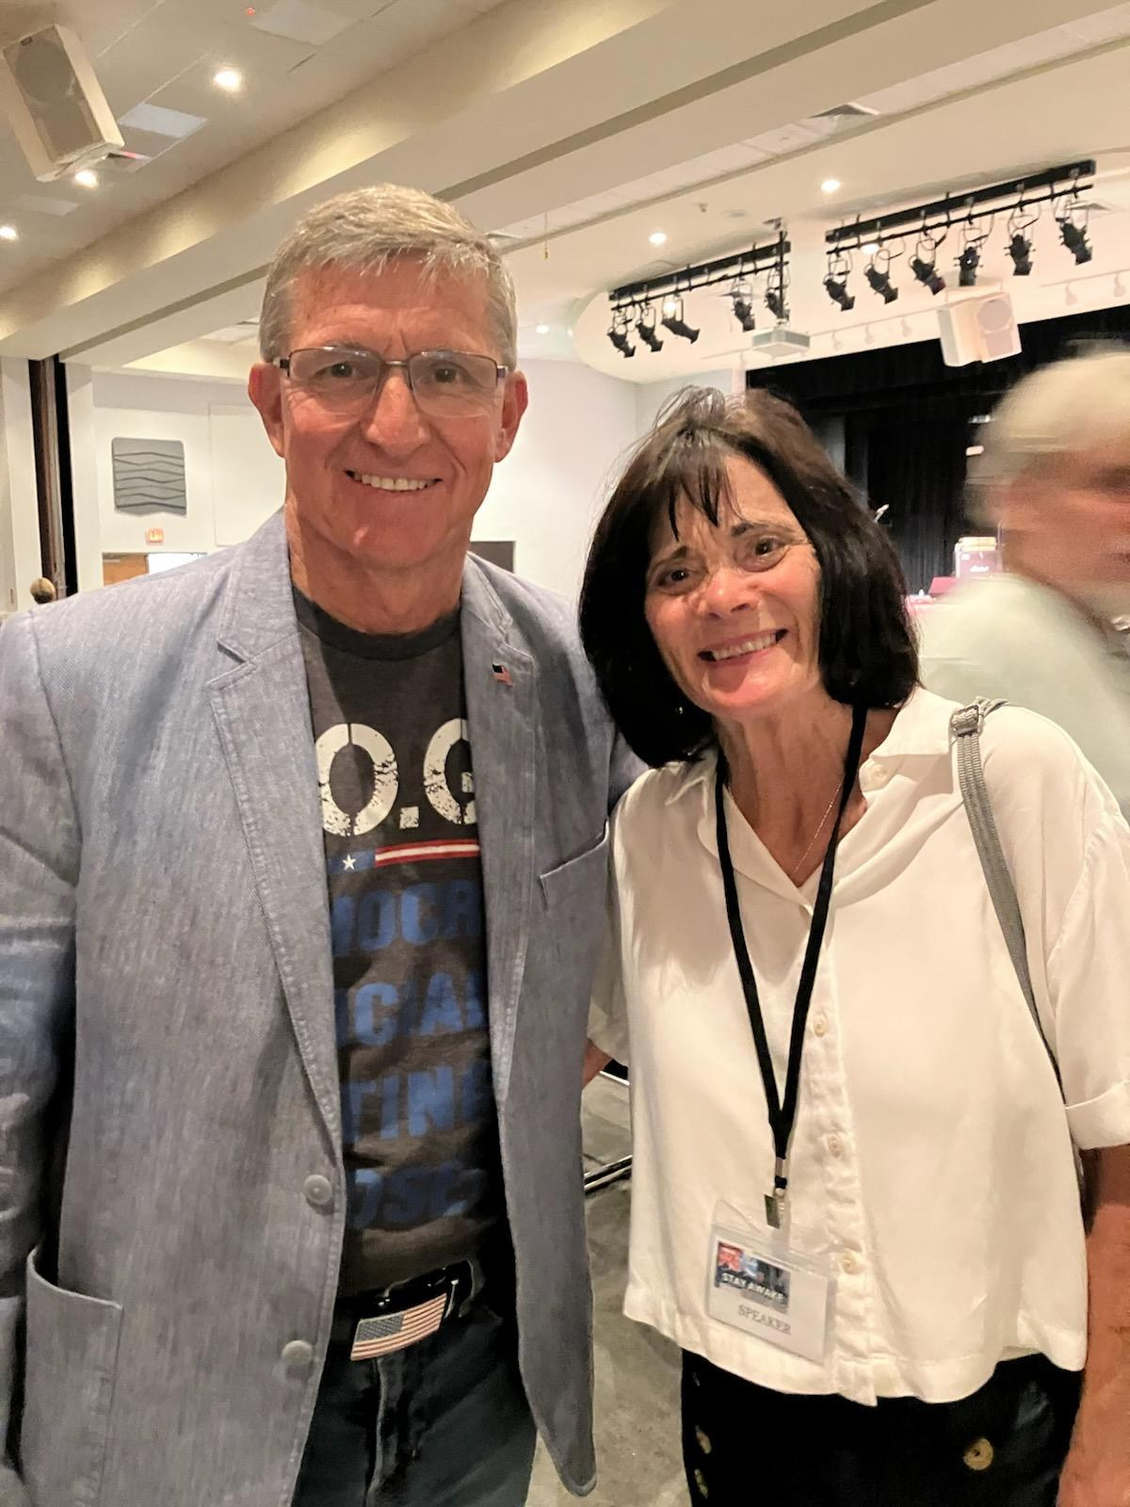
13 / 24
Gen. Flynn.

Slide 14

14 / 24
Saving God's Children banner.

Slide 15
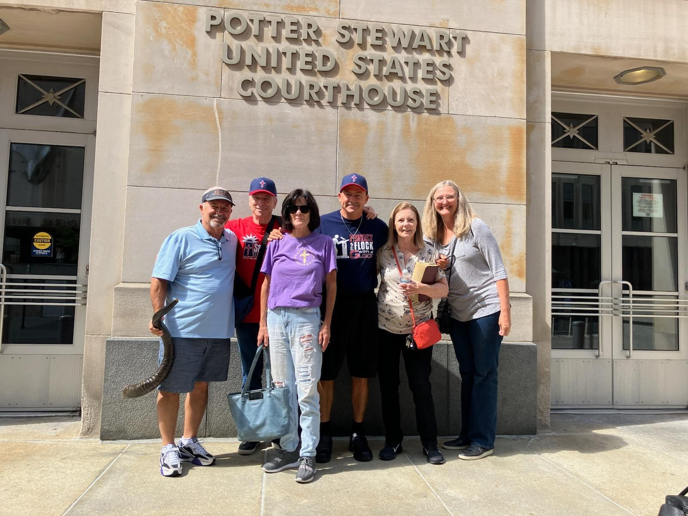
15 / 24

Slide 16
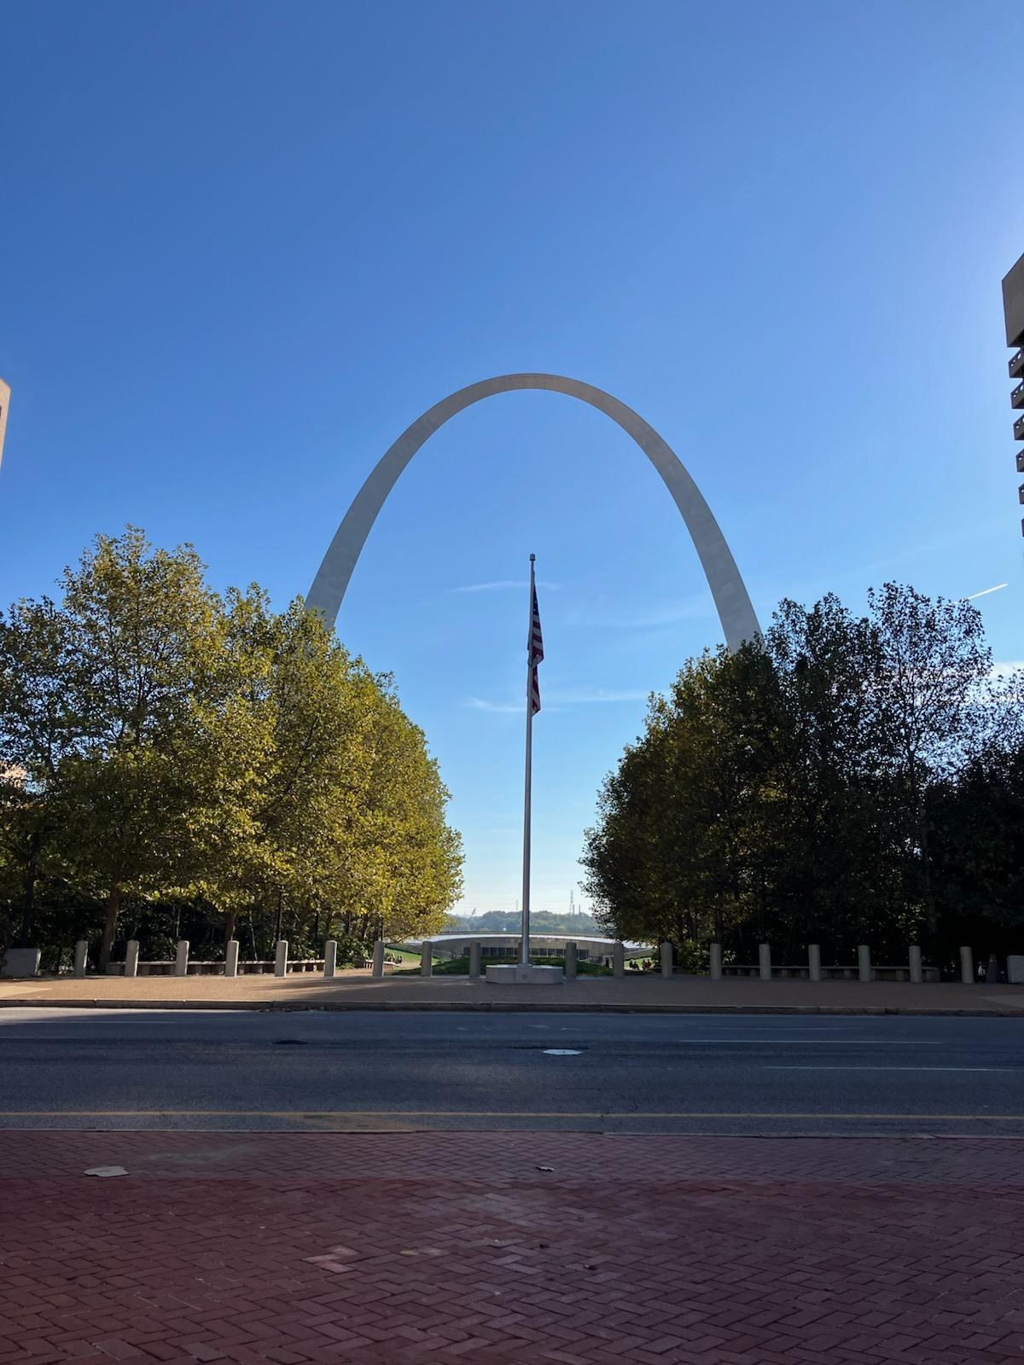
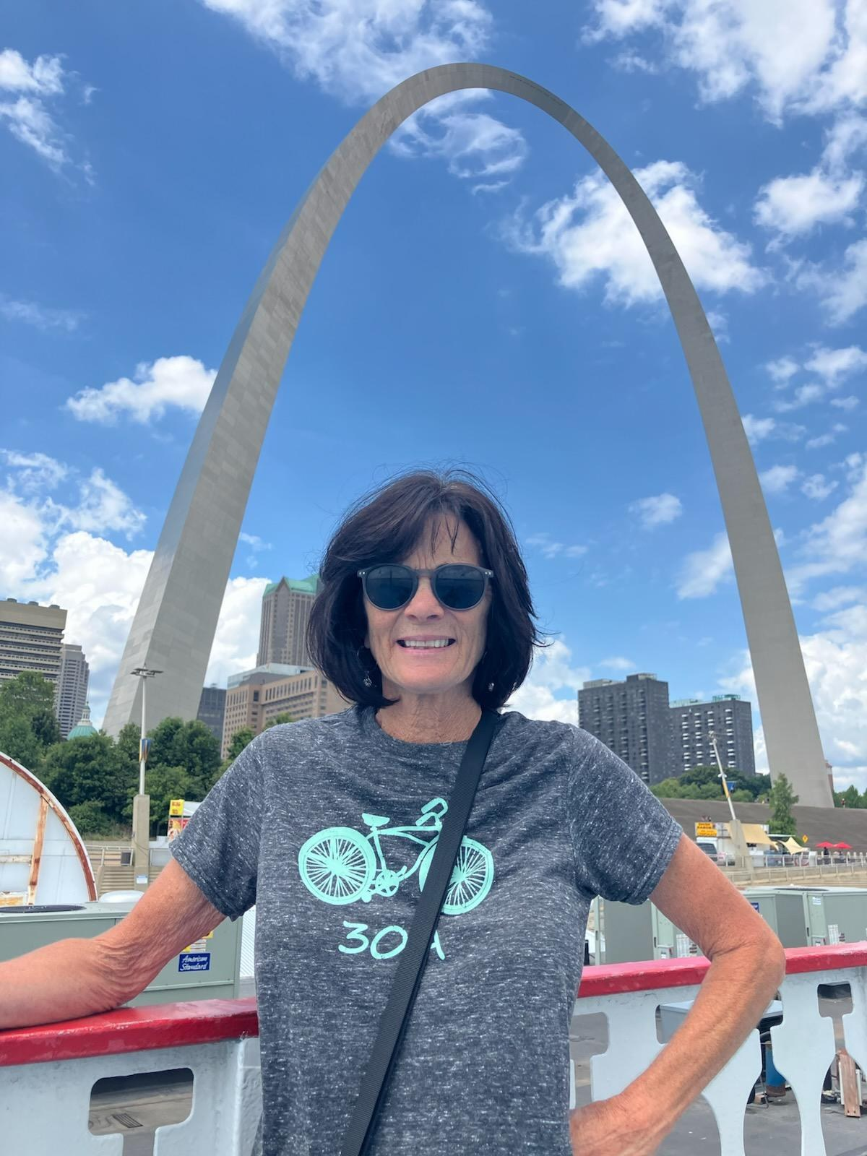
16 / 24
Gateway Arch.

Slide 17
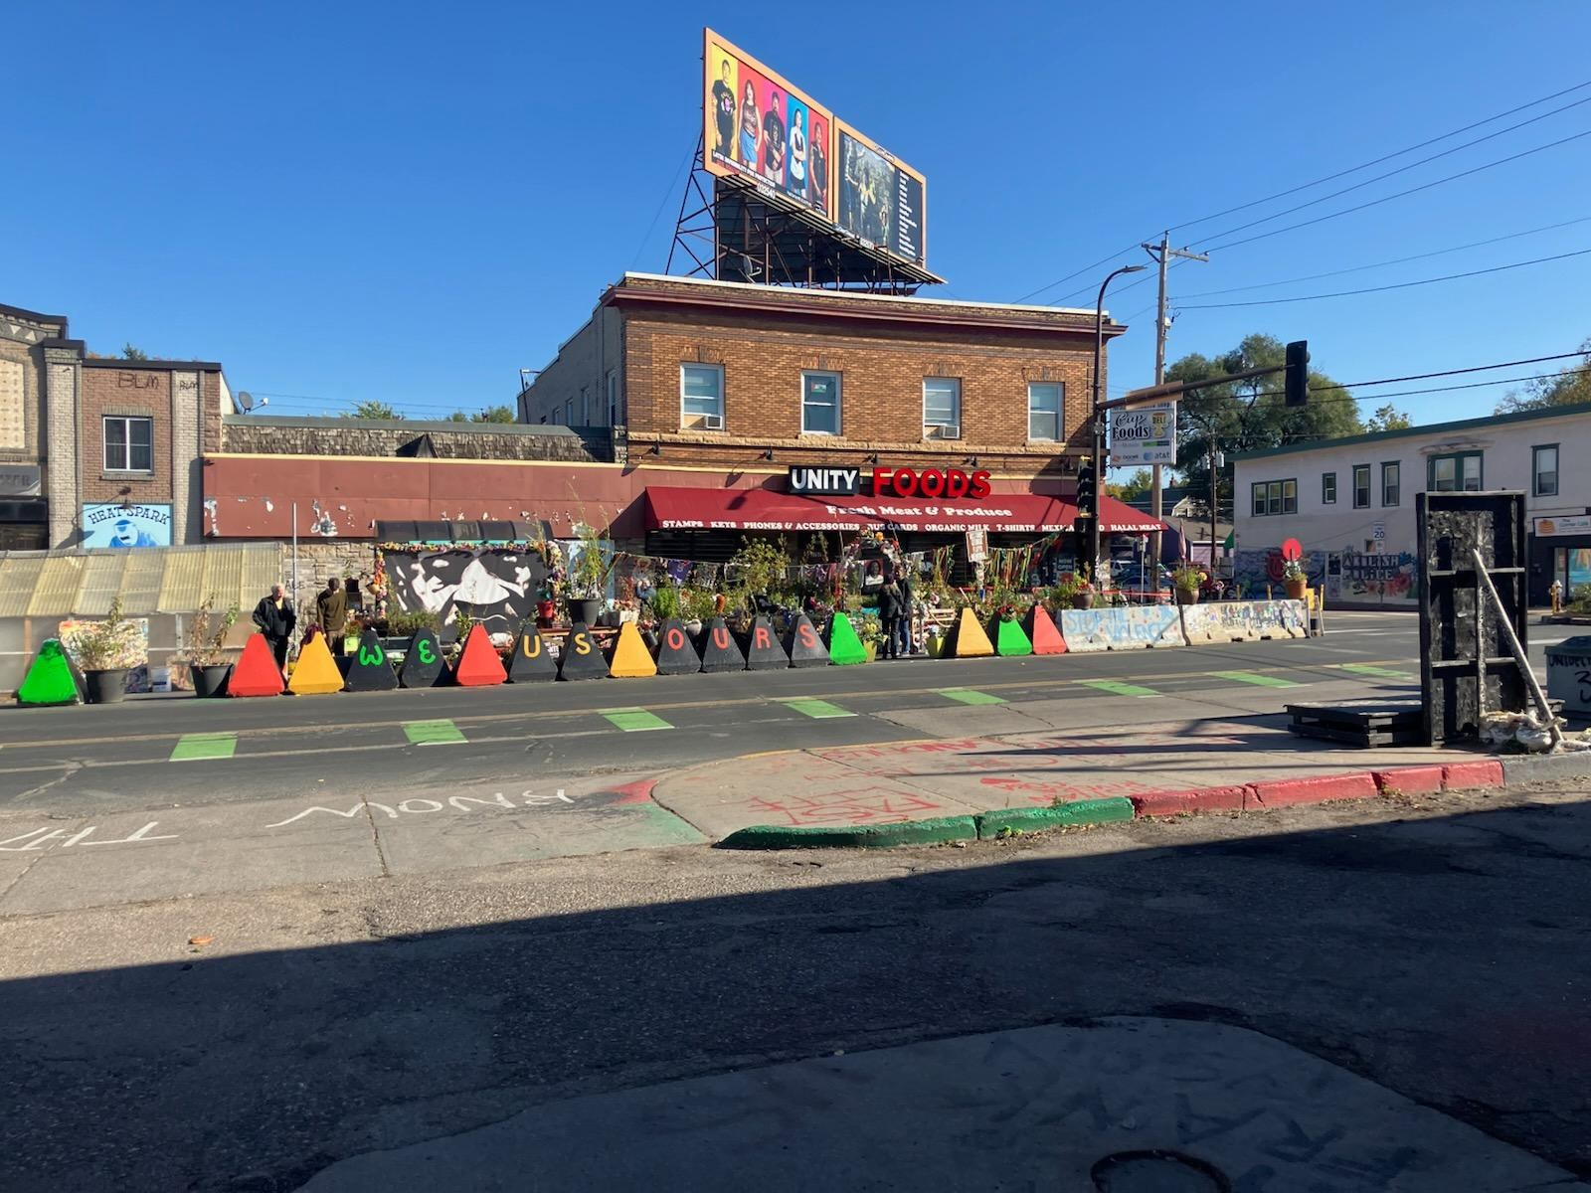
GEORGE FLOYD SQUARE
18 / 24
Minneapolis, Minnesota.

Slide 18
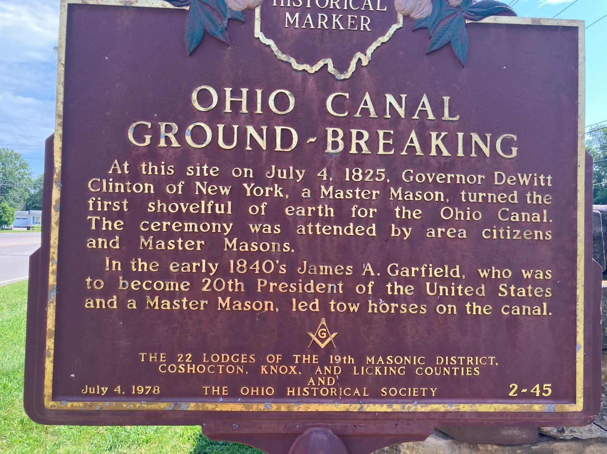
19 / 24
Historical marker, Licking County, Ohio.

Slide 19

20 / 24

Slide 20
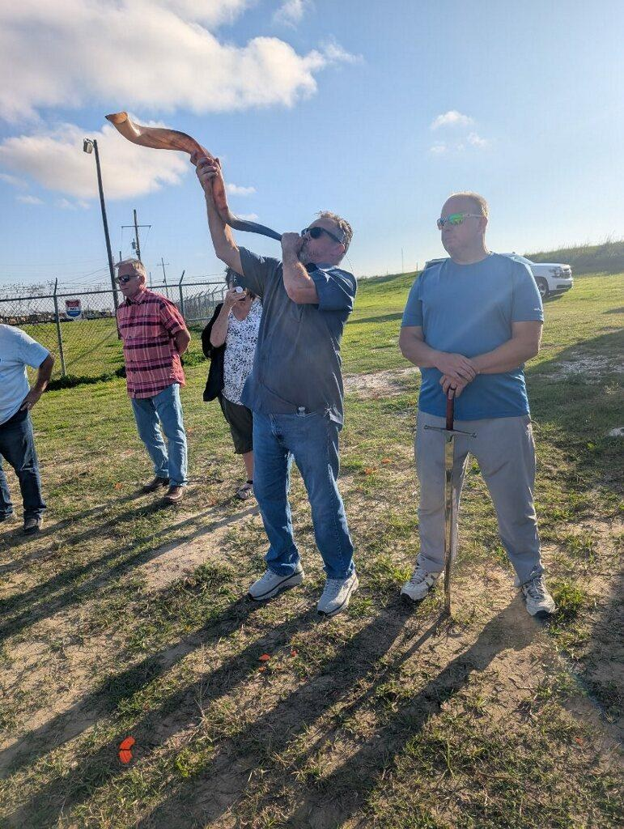
21 / 24
Sounding the shofar.

Slide 21
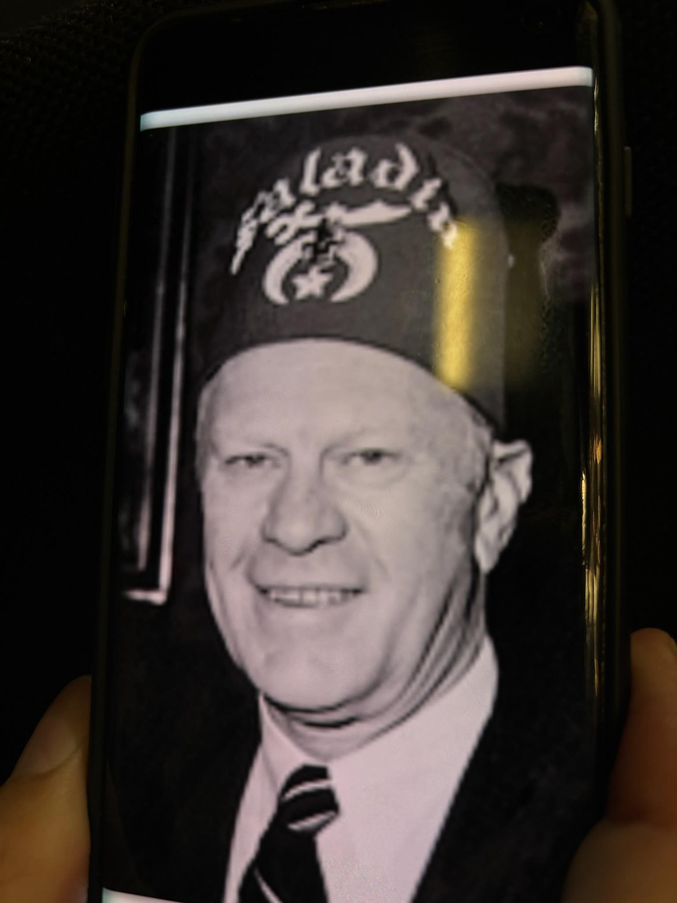
22 / 24

Slide 22
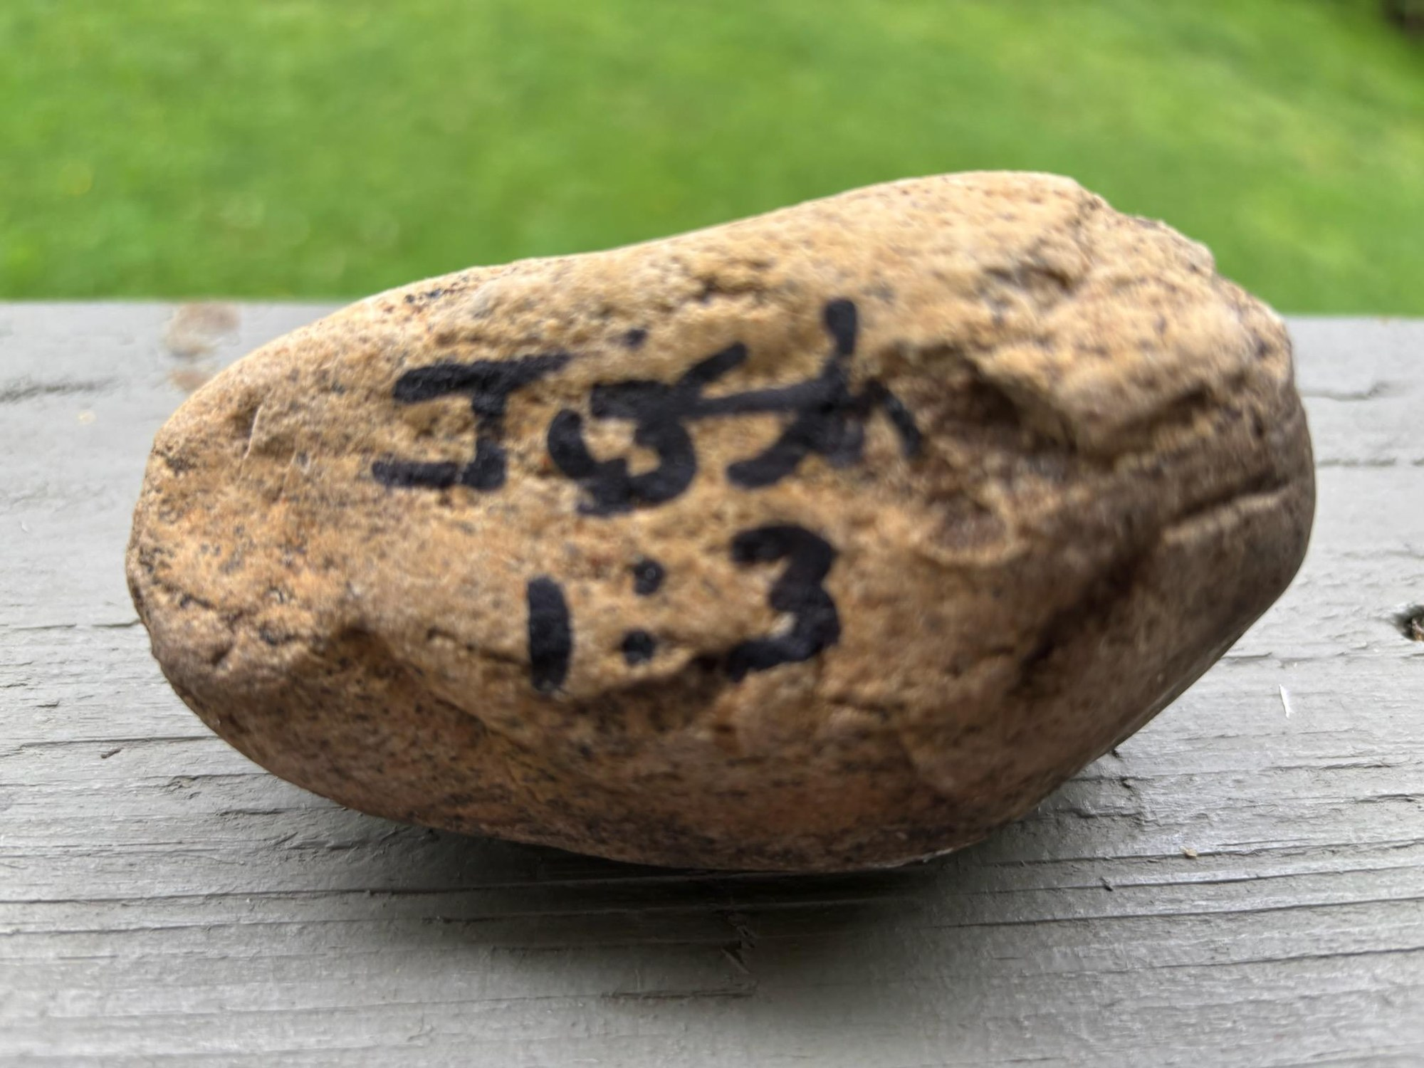
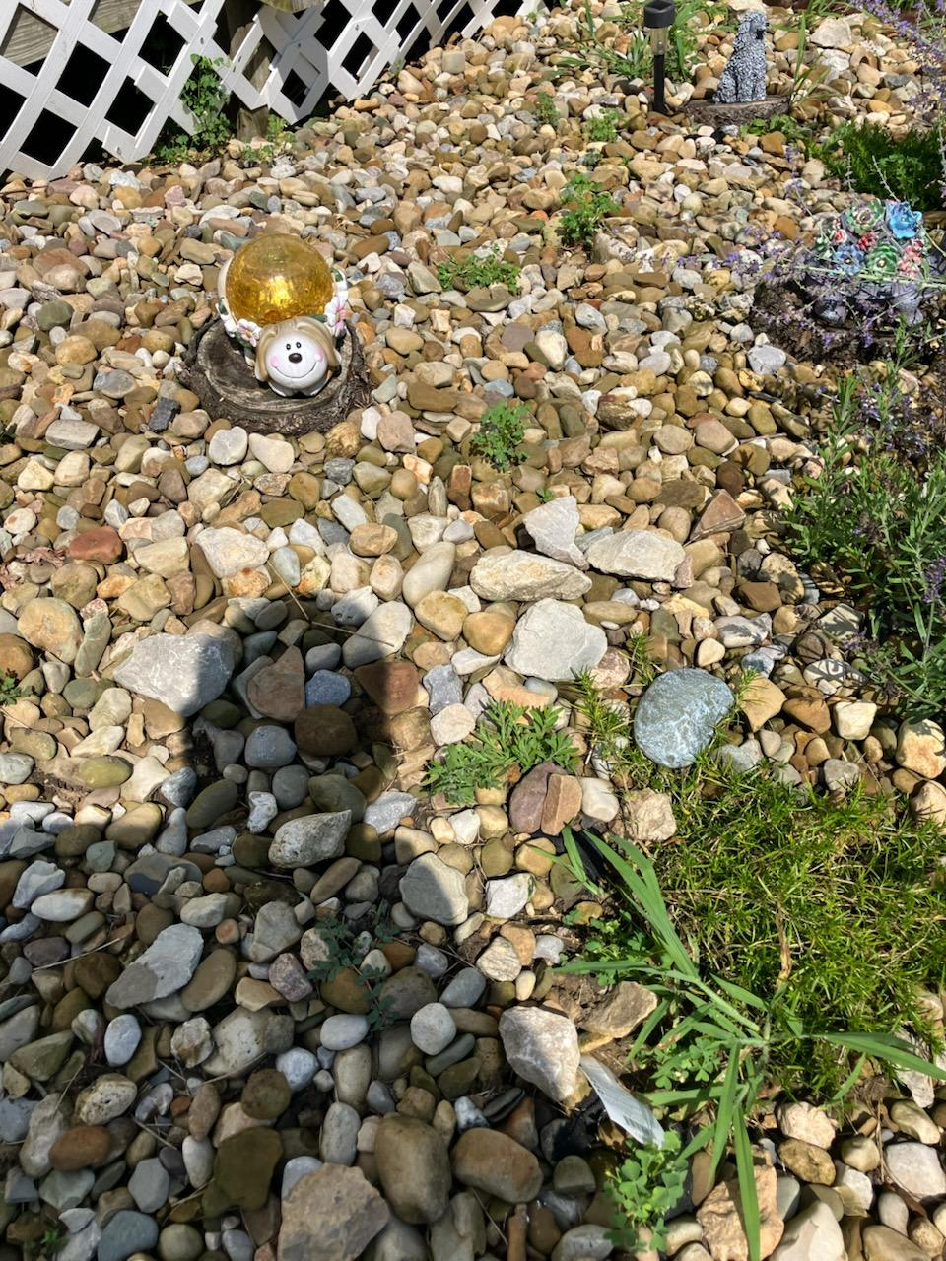
23 / 24
“I have given you every place where you set your foot, as I promised Moses.”
JOSHUA 1:3

Slide 23


